Slide 1
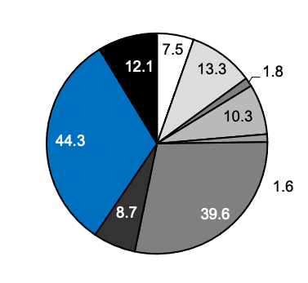
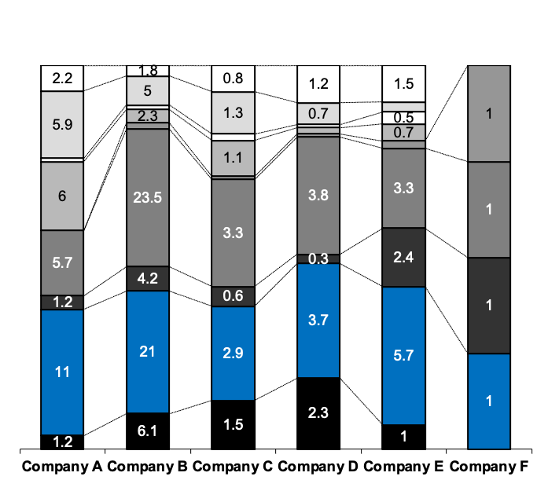
Controlling and Accounting activities bound 61% of the allocated capacities in Finance
Phase 1 – Creation of SSC
Analysis of Capacities Allocated in Finance
Example
Breakdown by activities
Breakdown by activities and subsidiaries
Total capacity allocated
in Finance (FTE): 139.2
Total (FTE)
33.5
65.7
11.8
12.4
xx
15.8
1. Mgmt. of finance
1. Mgmt. of
finance
5%
2. Accounts
Payable
10%
2. Accounts
Payable
9. Financial
mgmt. 9%
3. Travel & Expense
3. Travel &
Expense 1%
4. A/R, Collections
4. A/R,
Collections
7%
5. Credit
8. Con-
trolling
32%
6. Accounting
5. Credit 1%
7. Tax
6. Accounting
28%
8. Controlling
7. Tax
6%
9. Financial mgmt.
Note: (1) FTE – Full time equivalent; (2) A/R, Collections covers A/R and Collections; Accounting includes General Accounting, Ext. reporting, Cost accounting and Inventory accounting; Processing of acquisition and mgmt of fixed assets; Tax covers Tax planning and compliance, Tax accounting, Tax filling; Controlling includes Financial planning (budgeting), Outlook/interim forecast, Pricing and New businesses analyses, Mgmt. (business performance) reporting, Business performance analyses, Cost analyses; Financial mgmt. Treasury, Cash mgmt; Insurance, risk mgmt
Source: Data questionnaires for capacity allocation distributed and collected across Unipetrol subsidiaries in

Slide 2
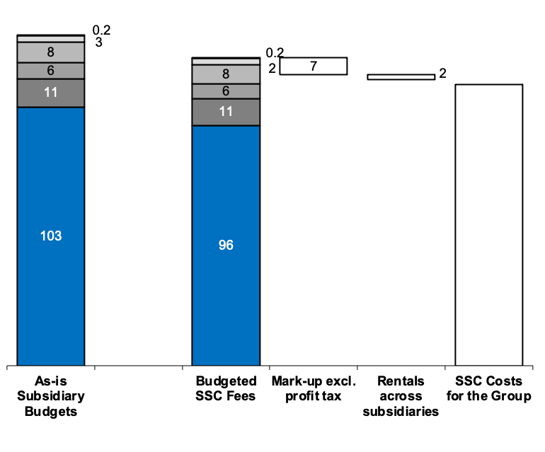
Creation of SSC is beneficial already in its initial year, i.e. during the running restructuring process
Phase 1 – Creation of SSC
Subsidiary Budgets vis-à-vis SSC Fees
(2007, CZK mil.)
Illustrative
131
Company F
-7%
123
-14%
Company A
114
Immediate savings for
the client
(before to in-depth reengineering)
Company E
Company C
Company B
Intra-group payments eliminated by consolidation
Company D
⁽¹⁾
Notes: Budget is calculated for the overall SSC size incl. non-staffed positions. Charged SSC fees include: Mark-up of 7.5%, restructuring costs and increased rental. EUR 1 ≅ CZK 28.
(1) Assumes that SSC will end up with a profit of 7.5%
Source: CEOs and Controllers of all participating subsidiaries,

Slide 3
Business Value and Operational Excellence of sites vary widely independent of current profitability
Aggregated assessment for 24 visited sites
Team assessment
Critical
3,8
Site x
Site x
Site x
Site x
Site x
3,3
Site x
Site x
Site x
Site x
Site x
Business Value w/o financials
Site x
2,8
Site x
Site x
Site x
Site x
Site x
Site x
Site x
Site x
Site x other
Site x modern line
2,3
Site x
Non-Critical
Site x
Site x
Site x
1,8
1,0
1,5
2,0
2,5
3,0
3,5
4,0
4,5
Production cost
Low
Operational excellence
High

Slide 4
SSCs are created by centralizing activities common to more than one company into a new unit
Summary of Assignment
Centralization of Services into SSC & SCM Units
Company A
Company B
Company C
Company D
Company E
Company F
Activities to be transferred:
Financial Accounting incl. Tax
Financial Management
Controlling
Procurement
HSE
IT
HR Management
Fuel Acquisition
Operations Planning
Logistics & Distribution
Customer Care
Shared Service Center &
Supply Chain Management
Number
of Employees: ~ 220
Shared Service Center
Supply Chain Management

Slide 5
In order to accelerate the launching of SSC we have focused on the client needs throughout the whole project
Approach to Client-Centric Delivery of SSC
Approach to Creation and Implementation of SSC
3 weeks
5 weeks
14 weeks
Key
Phases
Phase I
Shared Services Strategy
Phase II
Design & Construct
Phase III
Implementation
Conduct analysis of current status:
  HR capacities involved in functions in scope
  Costs related to functions in scope
  Equipment
  Identify subsidiary specifics
Identify savings and investments
Build and agree upon viable business case
Design required model for SSC
Evaluate locations for SSC
Identify requirements and design plan to achieve benefits
Develop initial communication plan
Documentation of key SSC processes, including interfaces
Analysis of existing contractual agreements and / or service level agreements
Documentation of all tasks
Dimensioning of tasks and processes
Definition of future targets
Compile detailed tasks for implementation
Compile master plan
Set-up tracking infrastructure
Focus on the client situation and context
Very close cooperation with client mgmt
Workshop mode of operation, role of coaching
Create the spirit of competition
Conduct as much parallel activities as possible
Ownership
Best practise (known representatives)
Communication
Special attention to Legal, HR topics (IT topics only secondary)
Main
Activities
Communication and Change Management
Communicate
  project objectives
  project progress
  agreed SSC blue print
Communicate the project conceptual phase outcome
Implementation communication

Slide 6
The project of creating a shared service center (SSC) can be performed in three phases
Phase 1 – Creation of SSC
Project Approach – Detailed for Phase I
Example
Today
3 weeks
5 weeks
14 weeks
Phase I
Shared Services Strategy
Phase II
Design & Construct
Phase III
Implementation
Communication and Change Management
Current Status
Conduct baseline analysis
Understand strategic role of SSC
Define scope of SSC and develop initial vision for each function to be included
Build and agree upon viable business case
Assess risks and mitigation strategies
Understand subsidiary issues and complexity drivers
Design blueprint model for SSC
Evaluate alternative locations for SSC
Establish high-level transformation roadmap
Identify requirements and design plan to achieve benefits
Develop initial communication plan
Key activities
ü
List of issue and complexity drivers
Blueprint model
Location evaluation
Implementation roadmap
Initial communication plan
Validated baseline
Vision for SSC
  scope definition
  viable business case
  risk assessment
ü
ü
Deliverables
ü
ü
ü
ü
ü
ü

Slide 7
Change Management is only working top-down and with sufficient “psychological strain"
Phase 1 – Creation of SSC
Behavior Patterns and Cascade of Change
Typical behavior patterns in change situations
Cascade of change:
New strategy:
"Walk as you talk"
Active
“Resistance fighter"
Strategy: Neutralize
“Pioneer of change"
Strategy:
Increase engagement
Top-Management:
Definition and exemplification of vision, mission and values
Executives:
Common understanding and dissemination of new vision, mission and values
Middle management:
Understanding and active exemplification
Employees:
Understanding to act accordingly
“Constant dripping"
of change
“Follower"
Strategy:
Actively involve
"Fan"
Strategy:
Offer opportunities to drive change
Passive
Negative
Positive
Top management support is crucial for ensuring buy-in of the organizational changes and the success of launch of new processes, structures and systems

Slide 8
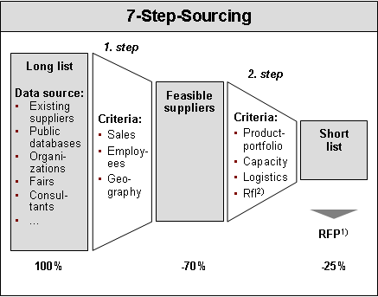
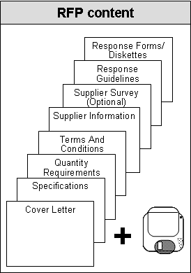

The classical sourcing methodology follows a structured
7-step-approach
Introduction: Why combine 7-Step-Sourcing and Cost Regression Analysis?
7-Step-Sourcing
1
2
3
4
5
6
7
Spend Profiling
Definition of
Sourcing Strategy
Supplier Portfolio
Generation
Selection of
Implementa-tion Path
Competitive Supplier
Selection
Operational Integration
with Suppliers
Continuous Benchmarking of Supply Market
Profile volumes, specifications, prices and suppliers
Profile purchasing practices and processes
Develop understanding of underlying requirements and specifications
Understand supply markets
Benchmark direct and indirect cost
Identify opportuni-ties to utilize con-tract agreements
Conduct value analysis to identify design and specification improvements
Assess bargaining position
Rank order oppor-tunities by sourcing category, set targets, establish work plan
Capture best new suppliers for back leverage with incumbent supp-liers
Conduct buying power assessment by sourcing category
Identify leverage points and refine savings targets
Select negotiation or competitive bidding process
Verify and adjust sourcing strategy
Develop imple-mentation plan, prepare RFP
Prepare analysis to support nego-tiations
Develop negotia-tion strategy
Execute RFP process, evaluate use of e-sourcing tools
Evaluate supplier proposals
Plan negotiation events
Execute compe-titive selection and negotiation
Conduct internal planning sessions
Manage supplier implementation planning sessions
Prepare transition plan and manage implementation
Capture lessons learned
Incorporate lessons into client's supply base integration process
Implement systems to track progress
Maintain best in class processes
…
…
…
…
…
…

Slide 9
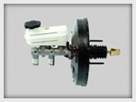
Cost regression analysis is done systematically in four steps
Introduction: Why combine 7-Step-Sourcing and Cost Regression Analysis?
1. Define scope of analysis on components level
2. Capture technical
and commercial
data
3. Set up and
validate the
regression model
4. Evaluate and
define savings potential
Negotiate with suppliers
Define component structure
Gather basic information
Identify cost variables
Develop data sheets and data request strategy
Gather and analyze technical/ cost data
Supplement data gaps with estimates
Determine regression variables and conduct analysis
Validate model results
Identify the target price line
Analyze and validate savings potential
Agree on and document potential findings
Integrate findings in negotiation strategy
Support in negotiation preparation
Savings potential
Savings potential
Purchasing
Controlling
R+D
Current price
Quality
Target costs of
sub-component, weight, …
System description (part system, components)
Basic info
Cost/performance drivers
Data sheets/ request strategy
Database with info
per component
  Specifications
  Cost data¹⁾
Cost model
Comparability beyond specification differences
Target costs on system level
Interpretation and documentation
Savings potential by platform, brand, vehicle, suppliers, …

Slide 10
Combining both methodologies creates a high momentum and ensures a constant utilization
Introduction: Why combine 7-Step-Sourcing and Cost Regression Analysis?
7-Step-Sourcing
Work
load
7-Step-Sourcing +
Cost Regression Analysis (CRA)
Momentum
Work
load
Step 1
Commodity
Profile
Step 2
Sourcing Strategy
Step 3
Supplier Analysis
Step 4
Implemen-tation path
Step 5
Supplier
Selection
Step 6
Imple-men-tation
Step 7
Continuous
Benchmark-ing
Time
Momentum
Cost Regression Analysis (CRA)
Work
load
Step 1
Commodity
Profile
Step 2
Sourcing Strategy
Step 3
Supplier Analysis
Step 4
Implemen-tation path
Step 5
Supplier
Selection
Step 6
Imple
men-
tation
Step 7
Continuous
Benchmark-ing
Time
Momentum
Step 1
Commodity
Profile
Step 2
Sourcing Strategy
Step 3
Supplier Analysis
Step 4
Implemen-tation path
Step 5
Supplier
Selection
Step 6
Imple-men-tation
Step 7
Continuous
Benchmark-ing
Time
The incremental effort by using both methods is relatively low

Slide 11
The CRA approach can be integrated without frictions and significant additional effort into the regular approach
Approach and Deliverables
1
2
3
4
5
6
7
Spend Profiling
Definition of
Sourcing Strategy
Supplier Portfolio
Generation
Selection of
Implemen-
tation Path
Competitive Supplier
Selection
Operational Integration
with Suppliers
Continuous Benchmarking of Supply Market
7-Step-Sour-cing
1
Define scope of analysis
2
3
4
Capture technical and commercial data
Set-up and validate regression model
Evaluate and define savings potential
Nego-tiation
CRA
1
2
3
4
5
6
7
Spend Profiling
Definition of Sourcing Strategy
Set-up CRA models
Supplier Portfolio Generation
Evaluate sa-vings potent.
Selection of Implementation Path
Competitive Supplier
Selection
Operational Integration
with Suppliers
Continuous Benchmarking of Supply Market
7-Step-Sour-cing
and CRA
Leverage-
back neg.
Savings are realized BEFORE RFP quotes are received

Slide 12
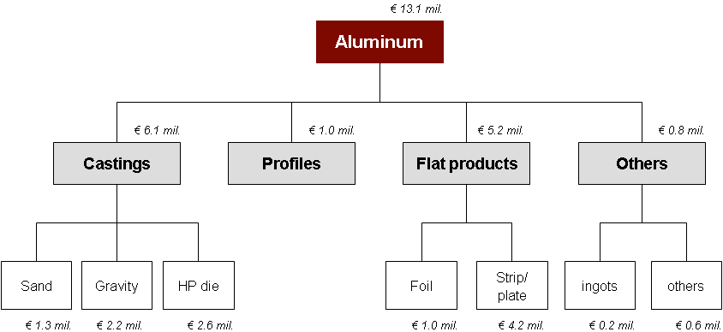
Most activities run in parallel avoiding frictions between both methodologies
Approach and Deliverables
Main activities: 7-Step-Sourcing + CRA
1
2
3
4
5
6
7
Spend profiling
Sourcing strategy
Set-up CRA models
Supplier analysis
Evaluate sa-vings potent.
Implemen-tation path
Supplier selection
Operational integration
with suppliers
Continuous bench-marking
Conduct leve-rage-back neg.
Profile volumes, prices and suppliers
Define relevant technical specifi-cations
Gather all rele-vant commercial and technical data
Understand supply markets
Conduct supplier focus groups
Map opportu-nities
Agree final eva-luation criteria
Set-up CRA models
Discuss CRA models internally
Develop list of Tier 1 and com-ponent suppliers
Profile supplier capabilities
Evaluate savings potentials
Select, prioritize suppliers for leverage-back negotiations
Develop RFP
Prepare quote analysis
Harmonize specifications
Prepare leverage-back negotiations
Conduct CRA-based negotia-tions
Evaluate supplier proposals
Plan negotiation events
Prepare negotiation deck
Define negotiation objectives
Finalize supplier agreements
Conduct internal and manage supplier planning sessions
Develop transi-tion plan
Execute levera-ge-back agree-ments
Execute new supplier agree-ments
Document long-term strategies
Prepare and execute category strategic sourcing cycling plan
Implement systems to track progress
…
…
…
R² > 80%
Supplier
1
Supplier
2
Supplier
n
Detailed data-base with commercial and technical data
Supplier strategy
CRA models
Supplier short-list
Savings potentials
RFP
First implemented savings
Quote analysis
Negotiations
Implementation plan
Market index
Savings tracking

Slide 13
For wave 1, we prioritized and chose four major categories, three additional categories will follow in wave 2
Case Study: Construction Equipment OEM - Approach
Selection
high
Wave 2
Raw
steel
Wave 1
Machined
parts
Product identification
& labeling
Castings
Steel
fabrications
Clamps,
ties, straps
Mechanical
components
Cylinders
Potential
Fittings,
adaptors
Electrical
components
MRO
Hydraulic
components
Crawler track
assemblies
Chemicals
Fasteners,
retainer rings
Gearboxes
Axles
Plastics
Engines
Tires
low
low
Ease of implementation
high
: Purchasing volume

Slide 14
There are five fundamental elements that are the foundation of a brand
  The [New retailer] Brand
"A brand is a collection of perceptions in the mind of the consumer"
What company does and for whom
It’s unique value and benefits
Key point of differentiation
What the customers should expect from every interaction
Positioning
Promise
Brand
Elements
Story
Personality
What the brand is to be known for
Personality traits that customers, and staff use to describe the brand
History and how the history adds value and credibility to the brand
Associations
Physical attributes: e.g. name, logo, colours, taglines, fonts, imagery

Slide 15
Every healthcare insurer has two ‘crucial’ capabilities: the composition of their ‘insured portfolio’ and ‘healthcare procurement’
Strategic healthcare procurement
Example
- The basic healthcare insurance value chain -
Best-in-class
- ‘Premium’ earnings
- settlement earnings
Core process
support
Composition
of the insured
portfolio⁽¹⁾
Company support
Distribution
Healthcare
procurement
Healthcare needs
Relative performance
Administrative
processes
Non-
Performing
Basic
Supporting
Crucial
Cost reductions for overall company processes
Optimized composition of the insured portfolio and healthcare procurement
Note: (1) The insured portfolio designates all the insured people

Slide 16
The healthcare procurement takes place through a standard 7-step sourcing methodology
- Generic procurement process -
Primary Procurement Process
Contracts
Contract Management
Supplier Performance Management
1
2
3
4
5
6
7
Profile
procure-ment segment
Evaluate
needs
Evaluate
basic suppliers
Choose procurement strategy
Compare suppliers
Integrate suppliers
Negotiate
Main spend cube statistics
Overview of current contracts and agreements
Overview of Total Cost of Ownership
Sourcing tree
Specifications
Procurement scenarios
Volume assessment
List with all suppliers and preferred suppliers
Supplier market analysis via various tools
RFI⁽¹⁾ packet and analysis (if applicable)
Annual healthcare segment procurement plan with selected procurement strategy
Concept healthcare segment contracts (modules)
List of suppliers for negotiation
Well-defined negotiation plan
RFP⁽²⁾ packet and analysis tool (if applicable)
Negotiated (modular) contracts
Implementation plan
Signed contracts
Main end products
Notes: (1) RFI = Request for Information
(2) RFP = Request for Proposal

Slide 17
The care providers market can be approached in two ways: by segment or by clinical picture (clinical picture management)
Clinical picture management
Optimal
scale size for tariff negotiations
Segment approach
Hospital nursing
Pharm-acies
Health aids
Spec-ialists
Para-medics
General Practit-ioners
Etc.
Maximum scale size through the application of specific procurement tools, such as commercial (tariff) negotiations
Chance of confrontation with certain groups of care providers
Clinical picture approach
Clinical picture
Geared towards the elimination of unneeded chain costs
Directed communication towards specific target groups is possible
Relatively easy to explain in a positive way to target groups
Elimination of ‘unneeded’ chain costs
These two dimensions require specific procurement processes and an organizational structure in which they can find an optimal place

Slide 18
Estimated development effort was expected to decrease significantly in the blueprint phase
Negotiation and mobilization
Contract structure proposed to
1
Negotiations
2
3
Blueprint
Realization
Approach to decrease price
Reduce estimated development effort by the agreed standard approach in the blueprint
Exit clause to be enforced after the blueprint if:
  Business blueprint is not approved and signed by the Steering Committee if:
    business processes design is not appropriate or complete
    Project objective of relying on not achieved
    …other criteria to be defined
If the exit clause is enforced, can perform the realization with another implementer
In order to prepare this option, the implementation service should be screened during the blueprint phase
Final fixed price for blueprint, project management and basis
Estimated fixed price for develop-ments and standard implementation
Analysis
Final fixed price for developments and standard implementation
Customization
Development
Project management
Basis
Assessment of implementers market
Kick off
Detailed Blueprint
Exit clause
The approach needs to be closely steered by the PMO
Price to be reviewed at the end of blueprint phase
Price established in the contract

Slide 19
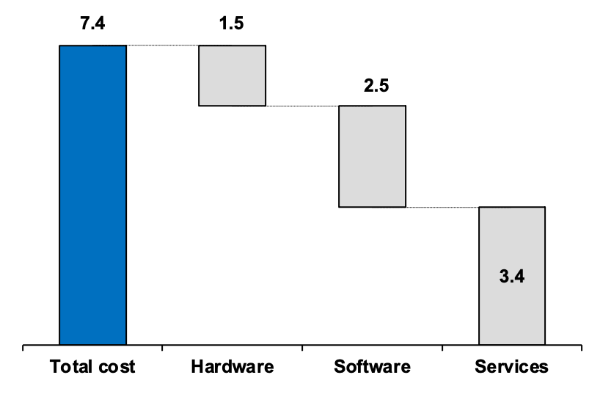
The investment cost refers to hardware, software and implementation services
Negotiation and mobilization
Based on previous offers
investment¹⁾ by types of costs
(mil. €)
One-time costs (mil. €)
Post implementation support
Hardware installation
Implementation
Annual maintenance costs are approximately 500.000 EUR which is
17% of the software value

Slide 20
Biggest part of investment costs occurs in 2021 and 2022 according to the global implementation roadmap
Negotiation and mobilization
Based on final offer
Implementation roadmap
July
2021
July
2022
December
2023
Assumptions
The 1st release
Further releases
The highest investment cost will be incurred in 2021, due to total hardware investment cost, part of software and blueprint cost
The largest amount of service costs will be allocated implementation period of 2021
There should be no more investments in system in 2022
Central functions, Mobile sales, Roll Out to Pharmacies, Stabilization
system investment costs by years (mil. €)
3.9
3.6
Hardware
Services
Software
1.8

Slide 21
Business benefits of the OOO investment occur after the system is implemented and stabilized¹⁾
Negotiation and mobilization
Business benefits identification
Illustrative
Step 1: Implementation
and stabilization
Step 2:
Benefits
realization
Benefits’ examples
Leverage purchasing power across divisions
Out of stock reduction
Efficiency due to process automation
Decrease in stocks rotation
Reduction of order fulfillment cycle
Efficient transport planning, reduction of unit transportation cost
Reduced lost sales due to stock-outs
Sales increase
Increase of Internal rate of return (IRR) on investment
Reduced cash-to-cash cycle time
Transaction processing
Improve reporting & controls
Reduction in HW and SW costs
Reduction in resource costs
Reduction in data center operations costs
Reduction in resource costs
Increased efficiency in employees re-allocation
Measure KPIs to establish baseline
Identify benefits based in measured KPIs
Potential benefits¹⁾
Logistics
Inventory Management
Break Even
€
Overall external and internal costs
Sales
Finance
IT
Costs
ERP
costs
Procurement
Benefits

Slide 22

We recommend phased implementation, with quick-wins to be captured in 2024, and the rest in medium and long-term…
High
Quick-wins: Year 2021
  Increase Out-network Penetration
  Enhance Supplier Sourcing Cost Management
  Enhance Dealer Management
  Improve Customer Relationship Management
Enhance Dealer Management
Increase Out-network Penetration
Increase % of Parts With Proprietary Technology
Enhance Supplier Parts Flow Management
Improve Customer Relationship Management
Improve Service Quality
Medium-term: 2021-2023
  Enhance Supplier Parts Flow Management
  Improve Service Quality
  Reduce Inventory Related Cost
  Reduce Packaging Cost
  Reduce Warehouse Cost
Enhance Supplier Sourcing Cost Management
Importance to Aftersales Profitability
Improve Catalog Management and Technical Competency
Reduce Inventory Related Cost
Reduce Packaging Cost
Grow Conversion Aftersales
Reduce Warehouse Cost
Long-term: beyond 2024
  Increase % Of Parts With Proprietary Technology
  Improve Catalog Management and Technical Competency
  Grow Conversion Aftersales
Low
Difficult
Easy
Ease of Implementation
Quick-wins
Medium-term
Long-term

Slide 23
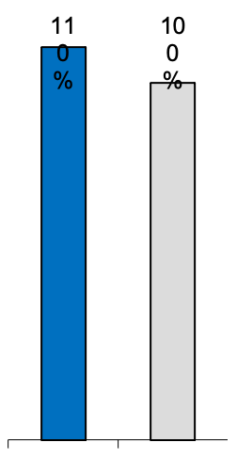
Case study: Charging license fee is an alternative way to collect out-network revenue, but increases difficulty in full supplier control in the future
FAW Out-Network Revenue Source from Management Fee on Licensed Suppliers
Parts Price on Aftersales Market
Explanation
Licensed suppliers: may or may not be authorized suppliers for whole vehicle; however, they still undergo a strict selection and evaluation process
Management fee: a fixed annual fee, between 100K-200K RMB, depends on the volume and value of the parts category
FAW has between 1-3 licensed suppliers within each parts category
110%
FAW
100%
Parts
License
Parts
License fee
(Management fee)
Comment
FAW Aftersales
Division
Licensed Suppliers
Pros
  Low cost: FAW only incurs certain SG&A costs such as QC, supplier selection/monitor cost
  Easy to implement: without the need to set-up large warehouse and distribution operation
Cons
  Impact in-network sales: low priced parts with FAW logo may reduce in-network sales
  Degrade brand image: inconsistent quality may degrade FAW brand equity in the long-run
  Loss of control in the future: OEM may have difficulties to take back out-network control in the future
Parts
Parts (with FAW logo)
Parts (with
FAW logo)
In-Network
Out-Network
With FAW logo from independent supplier
Independent brand without FAW logo
Customer
To mitigate long-term risks, collecting out-network revenue through license fee charge is not recommended

Slide 24

The automotive demand stagnates in developed markets, but has a steady growth in emerging markets
Global Automotive Demand Forecast¹⁾
(million units and CAGR)
Western Europe
Eastern Europe
-0.2% p.a.
+6% p.a.
Nafta
Japan
+1% p.a.
+1% p.a.
29%
9%
20%
7%
9%
18%
Latin America
China
8%
Asia & Others
+8% p.a.
+8% p.a.
+6% p.a.
X%
Notes: Automotive sales market share in 2023
1) Light vehicles including passenger cars and light trucks
Source: DRI WEFA

Slide 25
Spain, UK and Italy are expected to have the highest aluminum die casting volume CAGRs
Aluminum Die Castings in Automotive (Internal Combustion Engines)
European Geographic Regions Ranked by Growth 2021-2030¹⁾
Ø = 4.68%
Key findings
Average European CAGR 2021-2030 is expected to be 4.68%
Spain is expected to have the highest growth with CAGR of 5.18%, followed by UK (5.08%) and Italy (4.85%)
France (4.50%) and Germany (4.35%) are expected to have lower CAGRs than the European average
The spread in CAGR between various European countries is not large
Notes: 1) Automotive refers to light vehicles (passenger cars and light trucks)
Source: Global Industry Analysts Inc.

Slide 26
Analogous to the U.S. market a SaaS maturation time of about 10 years has to be assumed for Germany.
SaaS market – Market size and growth
Figurative
Market maturity evolution
Derived market maturity curve
(US)
Derived market maturity curve
(Germany)
Market maturity
Market maturity
High
Addressable SaaS market
Theoretically addressable SaaS market of about € 1 bn.
About 20% reduction due to addressable-actual difference¹⁾
High
About 20% reduction due to addressable-actual difference¹⁾
Maturity delay in comparison to US
800 m € actual market
Low
Low
1999
2010
1999
2003
2014
Relevant start of
ASP penetration in US
Relevant start of ASP
penetration in Germany
About 10 years maturation time
About 10 years maturation time
Reasons for S-Curve market maturation are especially license and depreciation cycles of software, crossing the chasm periods (between early adopters and mainstream), broadband penetration in the VSE segment, and the progression of market cultivation
Source: project team analysis
1) Difference between factual market and theoretically addressable market due to failures of market participants and not identified potentials

Slide 27
Client examples indicate that substantial growth can be realized if the right actions are implemented effectively
Selected client examples
Client examples
High tech products, solutions, and services
Technical equipment
Project
Project
-11%
+9%
+14%
+12%
Sales
(€ bn.)
-15%
+4%
+/-0%
+22%
Sales
(€ bn.)
Global growth and sales & marketing excellence project in more than 20 countries
Growth realized by
  Focus on attractive customers
  Sales force management
  Portfolio completion
  Partnership management
Global top-line driven transformation project in 16 countries
Growth realized by
  Sales structure redesign
  Value-based and customer specific pricing
EBIT optimization realized by
  Product portfolio flexibilization
  Asset utilization enhancement
  Holistic margin steering along the value chain

Slide 28
The Lean System framework allows to cover all generic efficiency drivers of a Service business
Service activity Efficiency model and standard levers
LEAN system dimensions
# contacts
Out of scope demand
Units
Inside scope demand
X
Non quality treatment
X
Specialization by demand or activity type
Average duration of treatment (ADT)
Time / unit
=
Process
X
Interfaces
X
Tools
X
Natural skills
Total costs
X
X
Specialization level
X
Organization
(specialization)
Process
Motivation
Quality of service indicator
Planning and scheduling
LEAN
system
Virtualization tools
Motivation &
Incentives
Quality vs. capacity mgt
Coefficient
Coefficient of security
Target quality of service
Specialization level
X
Wages
X
Skills
Overhead
cost
% present time / paid time
Holydays
X
Absences
Cost of one operational minute
Training
€ / time
% operational time / present time
Break
X
Administration
Management to staff ratio
X
Support to staff ratio
X
Administrative staff and G&A ratio

Slide 29
Likewise the industrial Lean methodology, there are 4 natures of optimization levers
Nature of
optimization
Nature of tasks
Levers
Key questions
Value chain collaboration
Self-care
Can we provide tools to client do it by himself ?
Calibrate the client demand
What is the information needed?
How to standardize data gathering?
Can we define answers by a MECE list of value?
Understand the task and the context
Improve quality of demand
Collect additional data
Automate collection
What is the information needed?
How to automatically gather information upfront?
Check data coherency
Suppress over quality
What is the use of this step?
Task treatment optimization
Restrain to specific cases
In which specific cases is it useful?
Automate tasks (entirely / part)
What is the standard process?
How many exception are there?
What are the IT constraints?
Treatment
Levers
Speed up
What are the useful shortcuts?
Can we download / interface upfront existing information?
Suppress over quality
Who uses these information?
Can we limit it to specific cases?
Trace the operation
Standardize written mode
Can we standardize by a set of values?
Process breaks
(external interfaces)
Minimize interfaces costs
Can we organize the process to perform human treatment in once?
Else, can we group activities requiring file comprehension? And automate as much as possible the file resumption?
Task reorganization & specialization
Internal tasks allocation
Specialization trade off
Tasks order
Maximize skills uses
Can we divide the process to maximize skills utilization?
Minimize set up times
How to order tasks to minimize IT set-up / response time?
Allocate files and tasks by ADT range
Insure a stable work rhythm
How to insure rhythm by the right files and tasks allocation?
Demand treatment order strategy
FIFO priorisation
Adapt when target is to treat 100% of standard flows
LIFO priorisation
Minimize average time of answer for a given production capacity
Prioritize short ADT files
Maximize the number of treated files for a given production capacity
Prioritize by client impact
Maximize satisfaction of high value clients

Slide 30
Each motivation lever should contribute to the entire motivation loop but presents individual characteristics
Motivation lever key questions
What is the relevant set of tools to use?
What is the relevant level of individualization?
What is the relevant frequency?
Process loop | Motivation tools | Impacted areas
 |  | Absence/delay | Breaks | ADT
Communicate | Suppress automatic withdraw (call center issue)
 | Communicate KPI targets
 | Team briefing
Monitor performance | Individual dash board
 | Team performance display
Develop skills | Monthly individual interview with manager + Skills matrix
 | Real-time monitoring (call center)
 | Observe process respect
Reward / sanction | Variable part of wages
 | Commercial or productivity challenge
 | Organize team events
 | Sanction abuses
High impact
Low impact

Slide 31
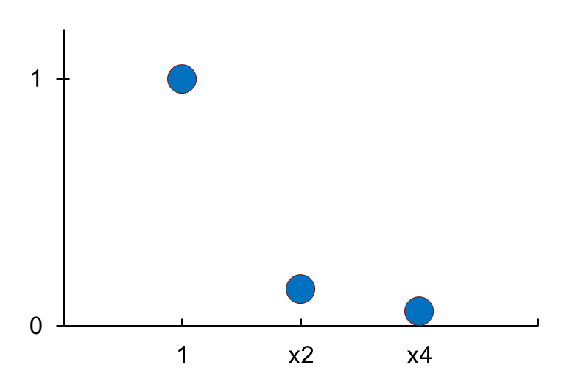
For a given Service Level target, occupancy rate will structurally increase with size
Overcapacity
needed to sustain
Service Level
Change in overcapacity in %
Overcapacity
reduction
by doubling the size
of the call center
Rule of thumb
Overcapacity
in %
x √ Positions = K
- 30%
- 50%
Constant
Change
in size
For a given service level
doubling the size of a call center allows to reduce the structural overcapacity by 30%

Slide 32
Sample - Captive center setup plan
Jan
Feb
Mar
Apr
May
Jun
Jul
Aug
Sep
Oct
Nov
Dec
Set up PMO Governance
Program Office
Manage Budget (financial management )
Manage Time (mobilize Transformation/Implementation Teams, Manage Progr, Manage Project Activities)
Manage Communications & Change
Define Receiving Center Requirements
Sending Activities
Document Processes to be Transferred and Develop To Be Solution
Manage Sending Side Impact and Change
Perform Job hand-over
Manage FTE ramp Down & Impact
Site Selection
Set up legal entity
8/11
Design & Build Site Infrastructure (incl. fit-out and IT)
9/15
Receiving Activities
Establish SSC Org and Operating prInciples
Dev. Training Materials
Recruit Key Positions
Recruit Operational Staff and Perform Training
Sourcing: Voice/Back Office/IT
Perform Job
hand-over
Receive post hand-over support
Primary role with
12/29
Primary role real estate team
Primary role with legal team
Primary role with sending team
Primary role with recruiting team
Primary role with receiving team

Slide 33
Several issues and opportunities were identified during the Finance-IT diagnostic
Finance-IT Diagnostic - IC Summary
Finance-IT Enablement Issues
Key Opportunities
Aging, Inflexible, Bolt-on Applications that are not Easily Modified And Maintained to Support Finance Models and Processes
Directional Opportunities
Finance Process Model and System Infrastructure Optimization
Using a standardized process model for E1 roll-out will facilitate accelerated consolidation of financial transactional processes
Optimization of FP&A processes across all regions will improve information quality through efficient decision support systems
Common application blueprint will leverage internal best practices in FP&A and TP across regions
Consistent master data definitions across all regions will enable visibility into global client and product profitability
Rationalization of Charts of Accounts across all countries will reduce configuration support costs and enable a quicker close
Designing and implementing a data warehouse that integrates financials from various regions will significantly enhance corporate-wide reporting and analytical capabilities
Establishment of product standards across key functional areas will ensure product commonality across the enterprise for FP&A (incl. Enterprise Planning, Budgeting, Forecasting) and TP functions
Sub-optimal Application Strategies and Standards that Results in Non-integrated Applications and Data Silos
Finance-IT Enablement
Proliferation of Shadow Applications to Support Finance Needs and Analytical Reports
Data Availability and Accessibility
Excessive Duplication of Systems across Countries and Lack of Investment Prioritization at a Global Level
Limited Use of Emerging Finance Applications in Key Finance Functions through the E1 Initiative
Software Product Rationalization
Source: (1) Interviews with Client Team Members XFinance-IT diagnostic survey across representative countries,

Slide 34
Size & skills provide competitive advantage to companies, while access to cheap funds provides sustainability
Industry assessment
Key Success Factors for Leasing Industry
high
Competitive Advantage
Size is required to facilitate: availability and flexibility of aircrafts, easier access to funds, better negotiation powers, global recognition, choice of customer, better risk management and lower per unit operation costs Skill are necessary To correctly preempt and manage the business cyclicality and to react quickly to the changing market conditions To provide innovative solutions and manage risk proactively
Aircraft
Number
Aircraft
Type
Skill
(Cycle management )
Aircraft
Age
Skill
(Innovation)
Cost of
Acquisition
Skill
(Risk Mana-
gement)
Barriers to Entry
Skill
(Relation-
Ship)
Brand
Recognition
Fund’s
Cost
Customer
Segments
Entry & Sustainability
Access to funds that are cheap allows easy entry into the industry Maintaining relationships with clients and ensuring their needs are understood and catered too allows sustainability in the business
Customer
Regions
Product
Offering
Fund’s
Availability
Operation
Cost
low
low
Business Impact
high

Slide 35
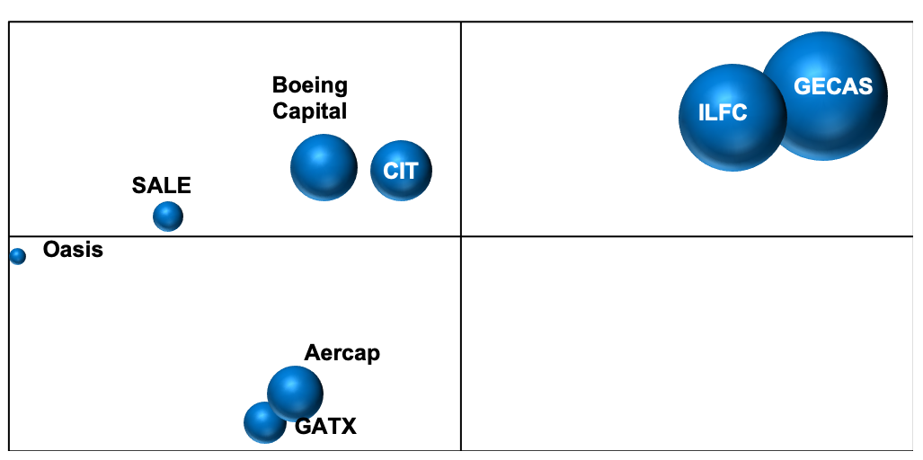
Large industry players perform better compared to the mid and small tier leasing companies
Industry assessment
Average ROA vs Asset size (2002 -2004)
Average ROA⁽¹⁾
2.0%
Large players show better returns when compared with their smaller counterparts
GECAS and ILFC have been consistently producing returns of over 1% of assets during the last 4 years
The returns of the mid and small tier players have a wide range from -5% to 1%
1.25%
0.5%
Mid-tier Players
Large Players
- 0.25%
(2)
Small Players
-7.0%
(2)
0
2500
5000
17500
30000
Fleet Value ($ Million)
Size Depicts the Size of the Fleet

Slide 36
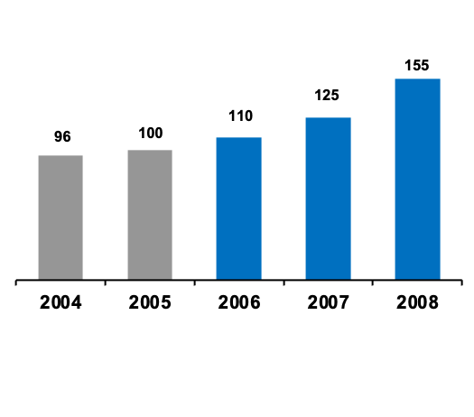
We supported the sales-driven turnaround of a leading power transmission and distribution equipment supplier
Sales-Driven Turnaround: Introduction
Illustrative
Sales-Driven Turnaround
Situation
Impact
(€ mil.)
Approach
Power trans-mission and distribution equipment provider
Partially com-pleted merger
Operational losses in 2005
Severe material cost increases
Lack of trans-parency in the organization
1) Pricing Quality Improvement
  Price transparency
  Price enhancement
2) Sales Excellence
  Sales organization / structures
  Sales steering
  Sales cost optimization
3) Margin Steering along the value chain
  Interweaved cost/price alignment
  Adaptive product design
4) G&A optimization
  G&A optimization
  Indirect costs optimization
5) Program management
1
2005-2008:
+55%
2
Sales
3
4
EBIT
3%
-10%
1%
5.0%
10%
5
Project

Slide 37
We implemented a rapid G&A optimization approach with typically >10% savings in focused 3-day workshops
Sales-Driven Turnaround: Introduction
4
G&A Optimization
Dedicated 3-day G&A workshops
Workshop impact
Day 1
Day 2
Day 3
(mil. EUR)
Align and discuss baseline
Identify and detail measures, and ex-change best practices
Consoli-
date measures
Non-
add-
ress-
able
spend
  Locked contracts
  Non-negotiable SLA and allocations
  Strategy and site manage-
  ment (excluded)
Discuss baseline
Clarify open questions
Understand activities per function and reasons for performance
Identify, prioritize, and
select measures
Evaluate and detail measures
Discuss levers and experi-ence from other workshops using a measure longlist:
Discuss results
Agree on
next steps
>10%
Add-
ress-
able
spend
Measure longlist:
> 100 measures
for measure
identification
  Total baseline
  Savings
  Addressed spend
  after measures

Slide 38
We established a strong backbone to steer the overall program with a multi-dimensional web-based tracking tool
Sales-Driven Turnaround: Introduction
5
Program Management
Monthly measure ramp-up
Measures by site
Program Management achievements
(mil. EUR)
(mil.
EUR)
DI 2
DI 3
DI 4
Program structure with twelve initiatives established
Responsibilities and targets for each initiative defined and drivers appointed
Measures tracking in web-based measure tracking tool with degree-of-implementation logic established
Measure impact calculation
in alignment with controlling implemented
Initial management rejection of measure tracking tool overcome by strong operatio-nalization and customization. Tracking tool used by all sites, regular reporting established
Implementation of about 500 measures ongoing
Site
Measures by initiative
Σ
(DI2 to
DI5)
(mil.
EUR)
DI 2
DI 3
DI 4
DI 2
DI 3
DI 4
DI 5
Initia-tive

Slide 39
A loosely defined property tax process means that CLIENT is likely overlooking property tax savings
Case for Outsourcing
CLIENT | CLIENT maintains relationships through 7 offices | Both CLIENT and service provider are at the mercy of municipalities | CLIENT employees manually validate assessments and bills by comparing to assessments and bills from past years and validating against their expectations | CLIENT launches few challenges, but has generally been successful when it does
Key Levers for Managing Property Tax Burden
Entry of Billing Information to IT Systems
Reduced Property Tax Burden
Relationship
with
Assessors
Flag
Questionable
Assessments/
Bills
Challenges
Service Providers | Service providers maintain relationship through 36 to 75 offices | Both CLIENT and service provider are at the mercy of municipalities | Service providers use computer models. For example, JJB maintains a database of all property tax assessments in Canada and can compare CLIENT to other companies in its sector | Service providers propose to file protective appeals on assets with potential for major reductions in property tax assessments Leverage experience and intellectual capital from a broad client base
Service providers expect a 5% decline in tax payments during first two years

Slide 40
Several key issues need to be taken into account in this evolution for short and long term success
MVNO entry strategy and operating model - Stages of evolution of Company MVNO business
CVI 비전 추진 경과
CRM 혁신
CVI 비전 이행
고객중심 사업설계
고객접점 변화관리
신사업 추진체계
임직원 역량 및 도전의식 강화
IT 서포터즈 육성
고객 니즈
교육체계 개편
고객 니즈/경험 관리
(’07~)
고객 관점 지표 강화 (’07~)
디자인 경영실 신설 (’07~)
본사
CRM 프로세스 혁신
(’05.5~’07.8)
CVI 비전 선포
(’06.12)
CVIC 신설
(’07~)
고객가치 중심 CFT 활동
(’06~)
본사의 업무 수행 방식 변화
고객에 대한 깊은 이해
고객 가치 개발을 위한 전사 역량의 통합, 조율 및 결집
고객 접점에서의 차별적 가치 제공을 위한 업무 수행 변화
고객
고객
고객 접점의 업무 수행 방식 변화
VoC 시스템 오픈
(’02. 8)
고객 부문 신설
(’07~)
유무선 복합 매장 오픈
(’06. 7)
결합상품 본격 출시
(’07. 7)
고객
접점
고객 밀착형 지점 체계
(’07~)
KT 온라인 사이트 통합
(’07. 10)
전국 단일요금제 등 출시 (’07. 11)
고객 서비스 강화
고객 중심 조직 개편
고객 중심 채널 개편
고객 중심 상품 제공

